Slide 1



On the Limitations of Carbon-Aware Temporal and Spatial Workload Shifting in the Cloud
Thanathorn Sukprasert, Abel Souza, *Noman Bashir, David Irwin, Prashant Shenoy
University of Massachusetts, *Massachusetts Institute of Technology
Eurosys’24 April 25

Slide 2
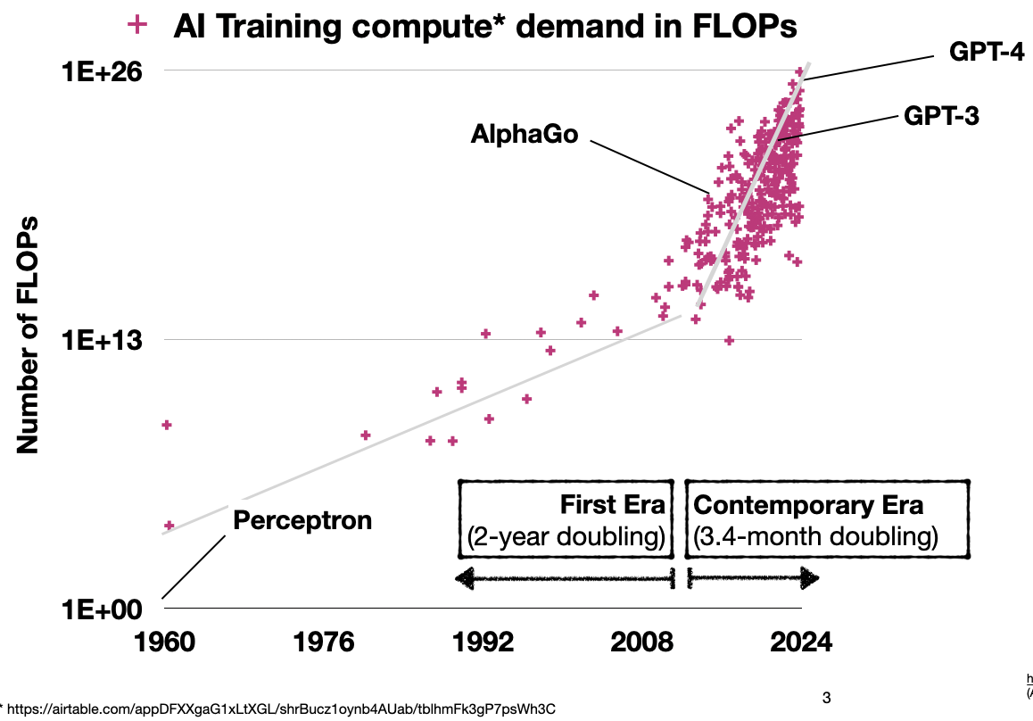
Introduction
Computing demand is increasing at a rapidly accelerating rate
training compute has grown by a factor of 10 billion since 2010
[1]
[1]: https://airtable.com/appDFXXgaG1xLtXGL/shrBucz1oynb4AUab/tblhmFk3gP7psWh3C
Notes:
To understand the context of this work, we need to first understand that computing demand is increasing at a rapidly accelerating rate part of the reason is from the rise of artificial intelligence such as ChatGPT. This figure identifies two eras of training compute the First Era where the training compute doubles every two years and the contemporary era where the training compute doubles every 3.4 months. The takeaway from this figure is that the training compute has grown by a factor of 10 billion since 2010.
.

Slide 3
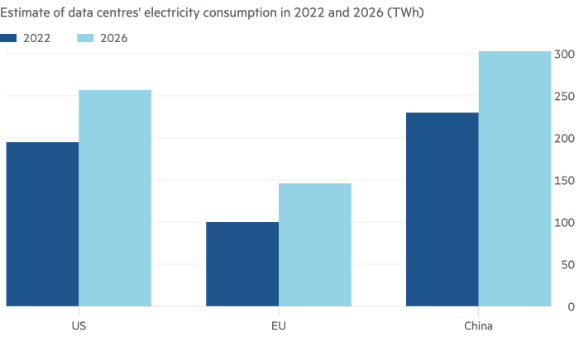
Introduction
Datacenters’ energy consumption is also rapidly accelerating
Energy Consumption (TWh)
[2]
[2] iea.org
Notes:
Next, datacenter energy consumption is also rapidly accelerating.
Globally, electricity consumption from datacentres, are projected to increase substantially by 2026. For example, the energy consumption in the US is predicted to grow from 200 TWh in 2022 to almost 260 TWh in 2026. In Europe, datacenter electricity consumption was estimated to be below 100 TWh in 2022, while is it projected to be at 150 TWh in 2026.

Slide 4
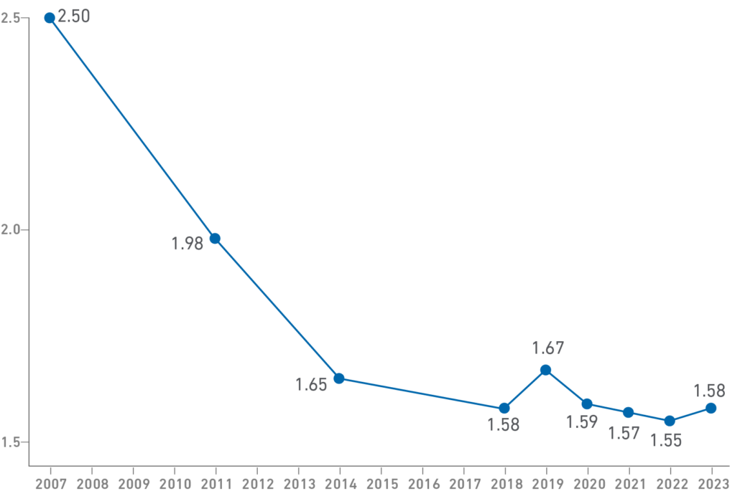
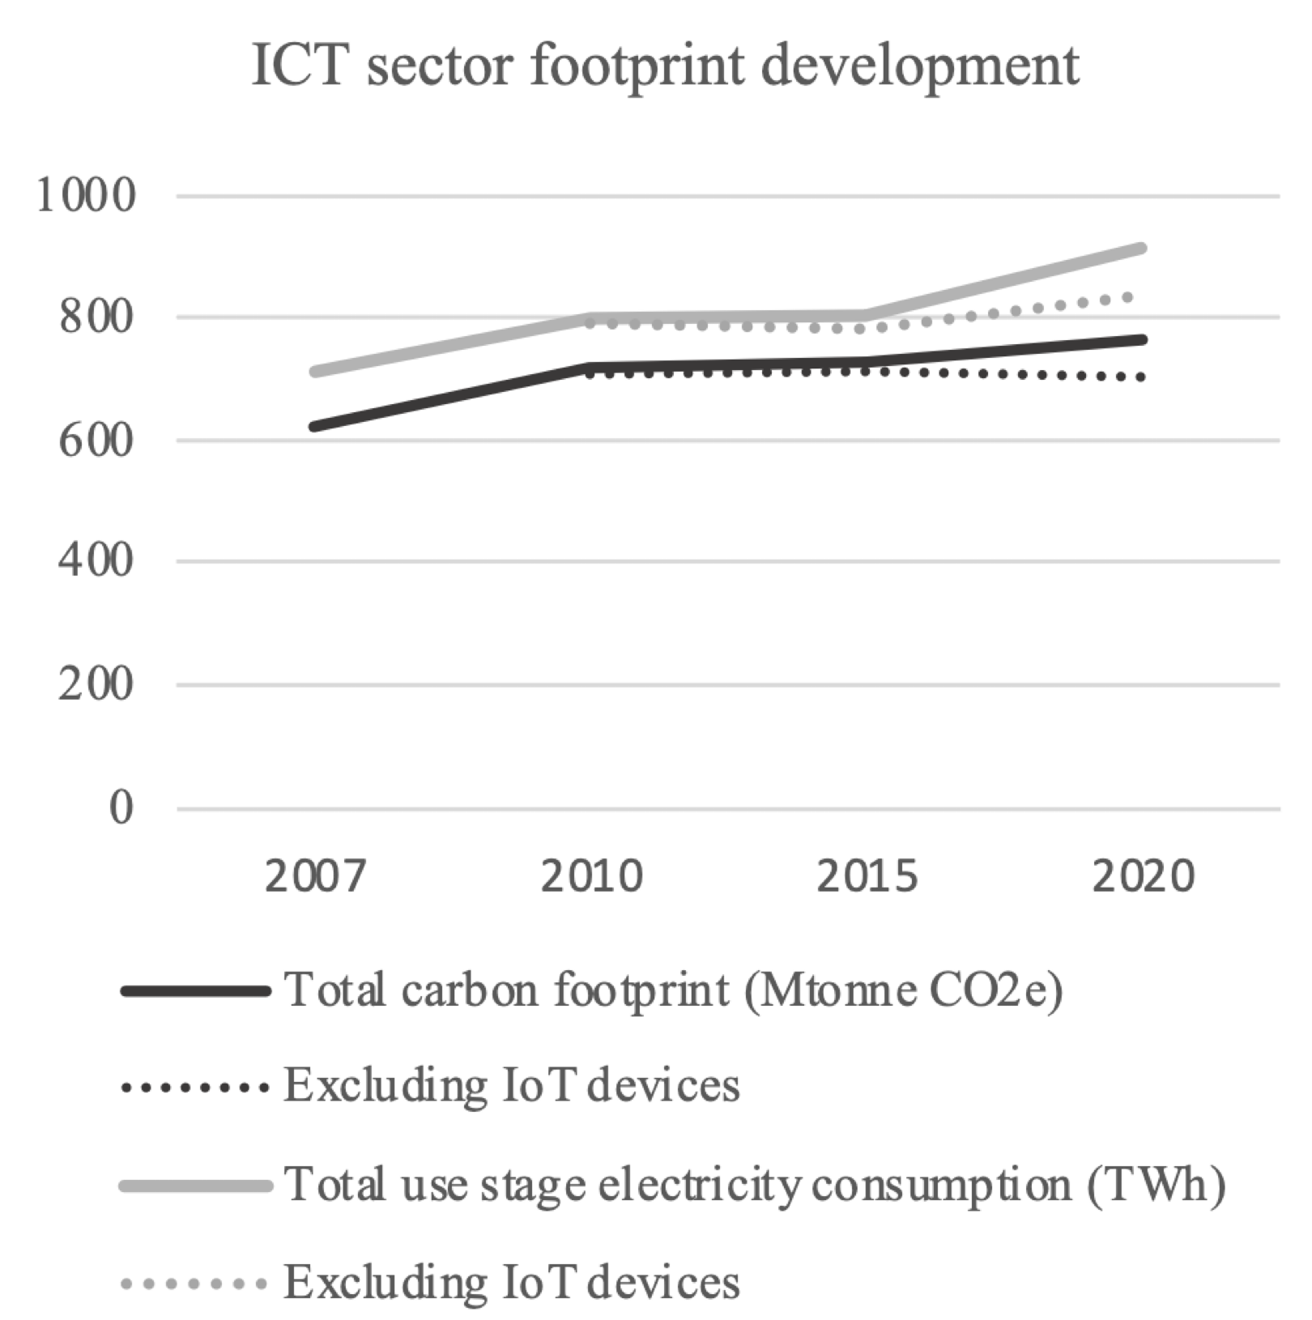
Introduction
Datacenters’ carbon footprint is also rapidly accelerating
Average Annual PUE
[3]
[4]
[3]: journal.uptimeinstitute.com
[4]:ICT Sector Electricity Consumption and Greenhouse Gas Emissions – 2020 Outcome
Notes:
While the computing demand continues to grow at a rapidly accelerating rate, the power usage effectiveness, PUE, however, is stalling. This causes the datacenters’ carbon footprint to also be increasing at a rapidly accelerating rate. This figure shows carbon emissions from ICT sector from 2007 to 2020. It can be seen that since 2015, the total ICT emissions have increased by around 5%.
As the computing demand grows at a rapidly accelerating rate,
the datacenters’ carbon footprint is also rapidly accelerating. This figure shows that the power usage effectiveness, PUE, is stalling and the growth in computing demand outgrows the gains in energy-efficiency
This figure shows that the power usage effectiveness, PUE, is stalling, however, as we discussed, the computing demand is increasing at accelerating rate. Since the growth in computing demand outgrows the gains in energy-efficiency, there is a rise in carbon footprint in the datacenters.
This figure shows carbon emissions from ICT sector from 2005 to 2020. It can be seen that since 2015, the total ICT emissions have increased by around 5%.

Slide 5






Introduction
Computing Demand
Energy Demand
Carbon
Emissions
Need to make
cloud computing
sustainable
Optimize for carbon efficiency
Notes:
So far, we have discussed that there is a rise in computing demand, which affects the increase in energy demand, and hence impact the carbon emissions in datacenters. As a result, there is a need to make cloud computing sustainable and one of the ways this can be done is by optimizing for carbon efficiency.

Slide 6




Carbon-Efficiency
PUE ~1: highly energy efficient
PUE ~2: highly energy inefficient
Coal powered
Solar powered
Highly carbon inefficient
Highly carbon efficient
Highly energy-efficient datacenters can still be carbon-inefficient
Notes:
Next, let me explain to you what carbon efficiency is
Supposed we have two datacenters one that is highly energy efficient, while the other one is highly energy inefficient. However, the first datacenter is powered by coal, while the other datacenter is powered by solar. This would mean that the first datacenter is highly carbon inefficient as it has high carbon footprint. However, the solar powered datacenter is highly carbon efficient for its low carbon footprint. In other words, the energy efficiency of a system depends on how much energy it consumes, while carbon efficiency of the system depends on how green its consumed energy is, regardless of the amount of energy consumed. So what this means is that highly energy-efficient datacenters can still be carbon-inefficient.

Slide 7


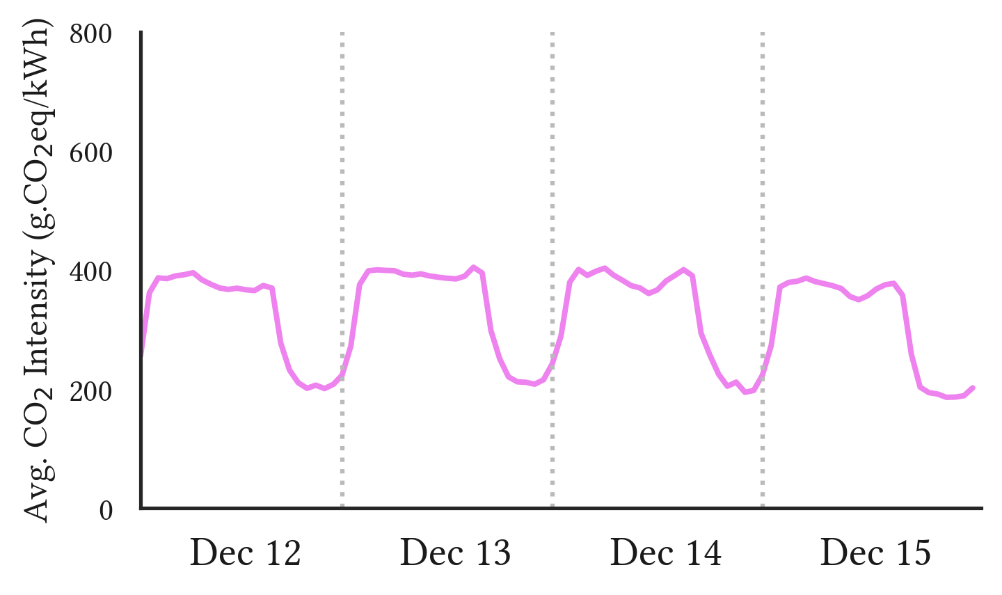
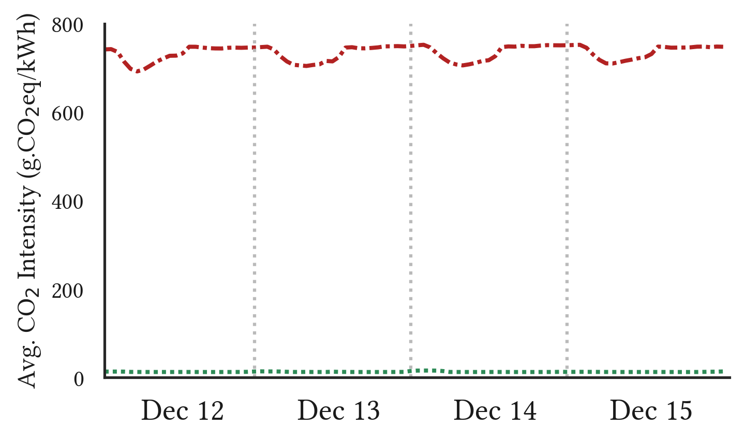




Optimizing for Carbon-Efficiency
California
Region R
Temporal Shifting
Spatial Shifting
Sweden
Harness the variations of carbon intensity across time and locations
Notes:
Next, I am going to explain how we can optimize for carbon efficiency. Let’s look at the carbon intensity in California where there is a low-carbon period during the day for its solar availability and high carbon period at night when there is no sun. Now let’s suppose we have a workload that needs to be executed. Instead of running the workload right away, we can schedule the workload during the low-carbon periods, this is called temporal shifting.
Furthermore, let’s supposed we have two regions, region R with high carbon intensity for the electricity is coaled powered and another region, Sweden, with low carbon intensity for the electricity is hydroelectricity. Instead of running the workload at the high carbon region, we can migrate the workload to the low-intensity region, this is called spatial shifting.
This can be seen that optimizing for carbon efficiency can be done by harnessing the the variations of carbon intensity across time and locations.

Slide 8
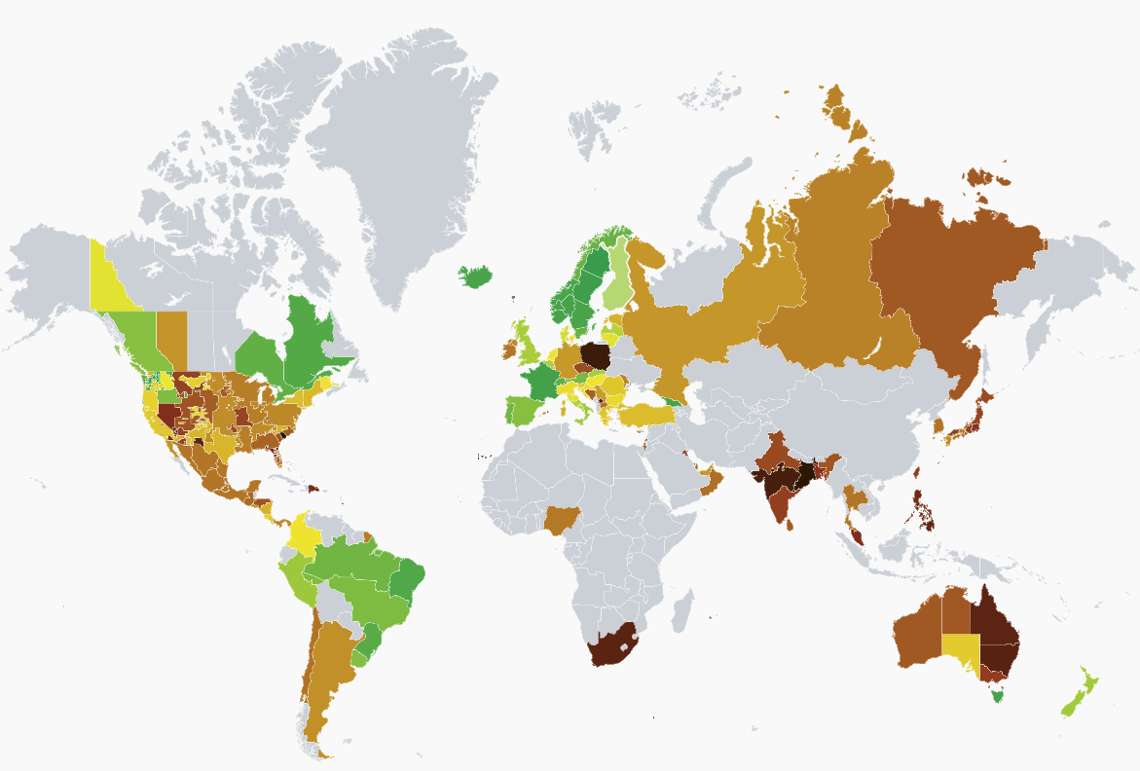
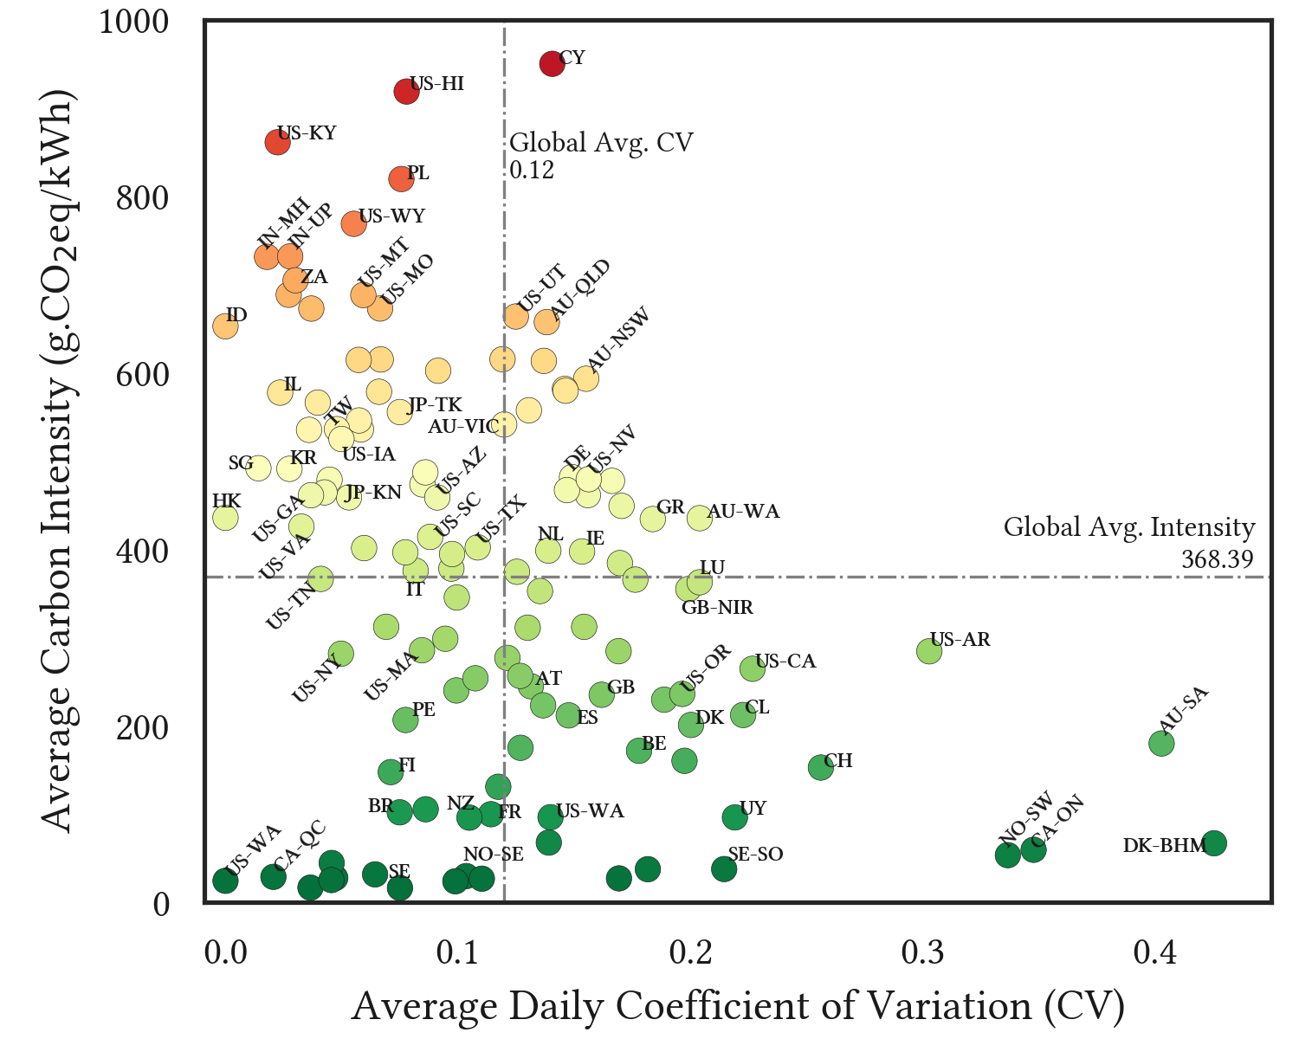
Research Question
Variations in the carbon intensity worldwide, both temporally and spatially
The potential benefits of spatiotemporal shifting are unclear
Notes:
Since temporal and spatial workload shifting depends on the magnitude and variability of carbon intensity of a region itself and a group of regions all together, it is unclear what the potential benefits of temporal and spatial workload shifting are at the current state of the world

Slide 9
Our Work
Quantify the potential benefits and limitations of carbon reduction from temporal and spatial workload optimization
123 regions from Electricity Maps
Cover 99 datacenters
From 2020-2022
Notes:
Explain the scale
Total locations. DC locations, year, data resolution
As a result, our work focuses on quantifying the potential benefits and limitations of carbon reduction from temporal and spatial workload optimization
We used the dataset consists of 123 regions from Electricity Maps, encompassing 99 datacenters from Electricity Maps from the year 2020-2022 to conduct this analysis

Slide 10
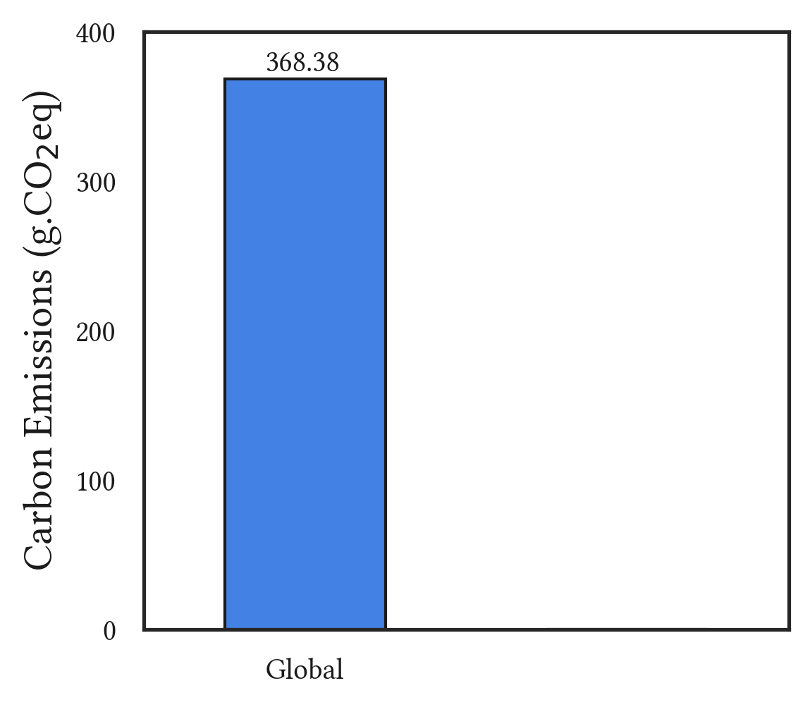
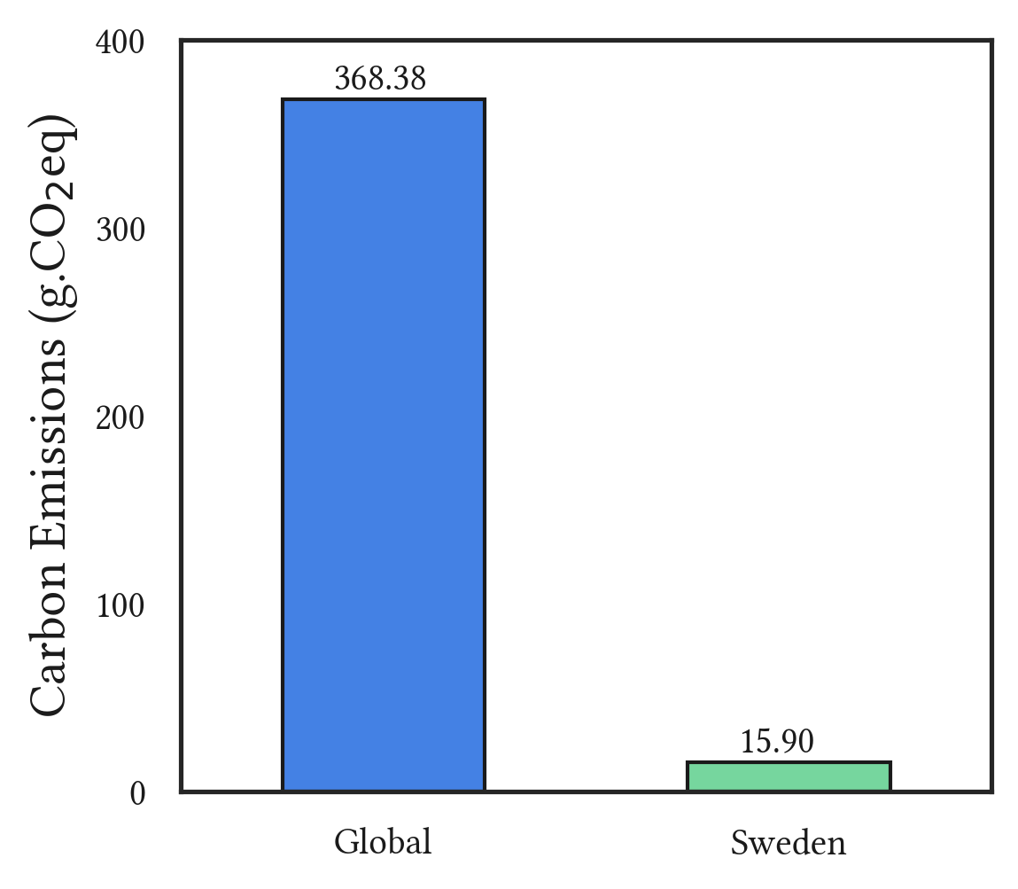

Spatial Workload Shifting
Migrate a 1-hour batch job the lowest carbon intensity location globally: Sweden
96% carbon reduction!
🌎
Notes:
Let’s start with spatial workload shifting by migrating a 1-hour batch job the lowest carbon intensity location globally, Sweden. The average carbon intensity across all 123 regions is 368 gCo2Eq… and by migrating all the job to Sweden, we can reduce the carbon emissions of the job to about 16 gCOeq.
What this means is that if everyone migrate their workload to sweden, we can reduce the carbon emissions of the whole world by 96%.
The figure on the right shows an average emission of a 1-hour batch job for each geographical region before getting migrated to Sweden.
This result shows that there is a seemingly a large potential for carbon reduction for spatial shifting
average carbon intensity globally is 368", mention “the average carbon intensity globally, across all the 123 regions, is 368 gCo2Eq…

Slide 11
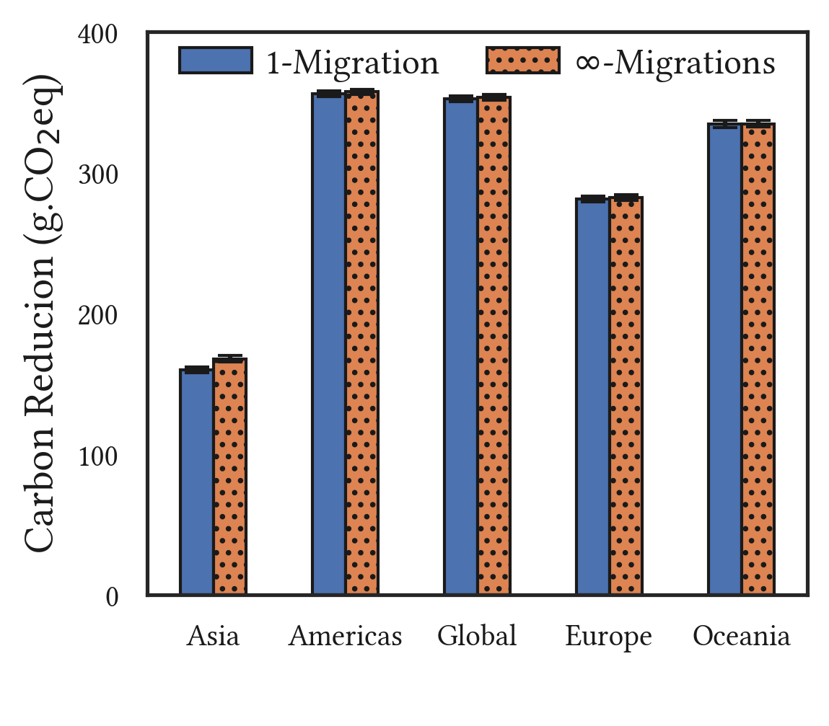
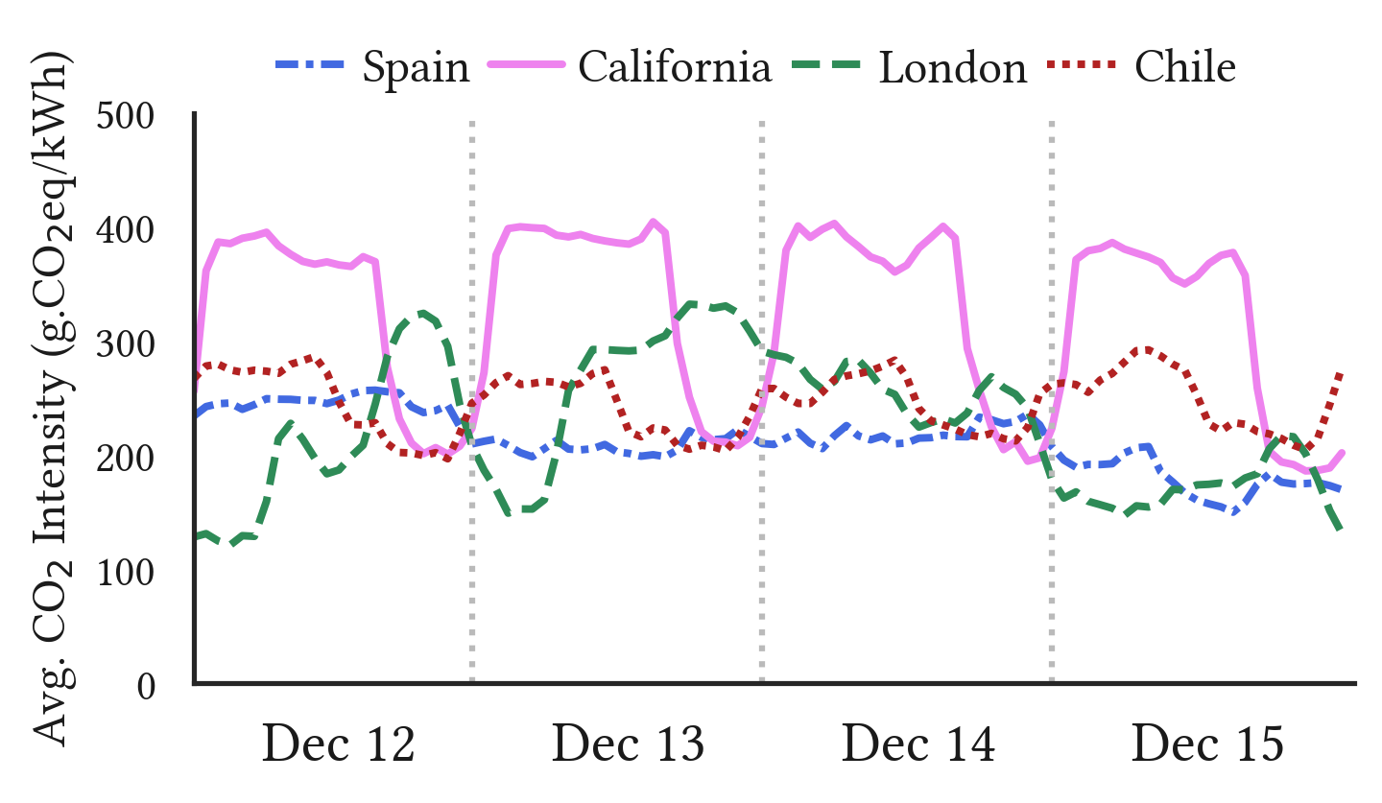
Spatial Workload Shifting
Migrating once yields most of the carbon reduction
Notes:
Before we discuss the constraints, When migrating the workload, a question one may ask is that do we need a sophisticated migration technique to harness the lowest carbon intensity value at any given point in time. However, our analysis shows that if you can migrate to any region around the world, migrating once yields most of the carbon reduction. This is because while there are variability in carbon-intensity between particular regions, most of the carbon traces ordered such that complex techniques are not needed. Note that while there is a data transfer costs depending on the size of workload, we are only showing you the carbon reductions resulting from the spatial migration.

Slide 12
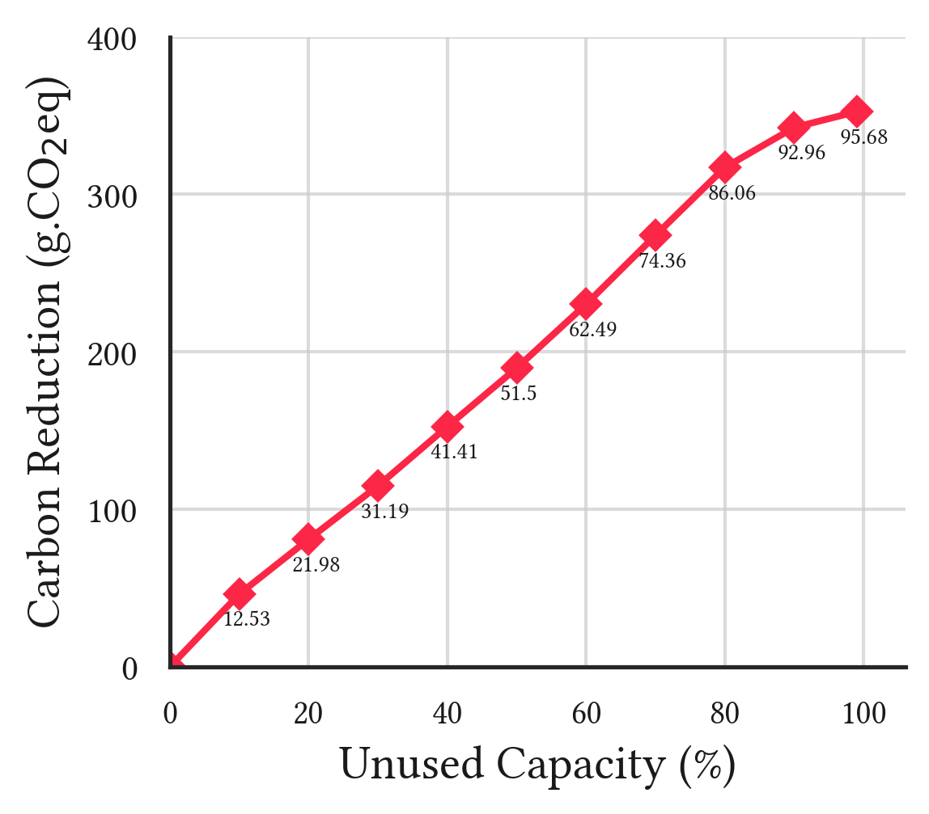
Spatial: Capacity Constraints
However, every region has a capacity constraint
Capacity constraints dimmish the carbon reduction opportunity
Notes:
So far, I have been implying that we should all migrate the workloads to Sweden. However, every region has a capacity constraint. Our result shows that the capacity constraints dimmish the carbon reduction opportunity. As you can see from the figure, as the unused capacity decreases, the carbon reduction also decreases.
On top of that if we want to have high carbon reductions from spatial shifting, there will be an increased idleness in high intensity regions, and in over-provisioning in low intensity regions.

Slide 13
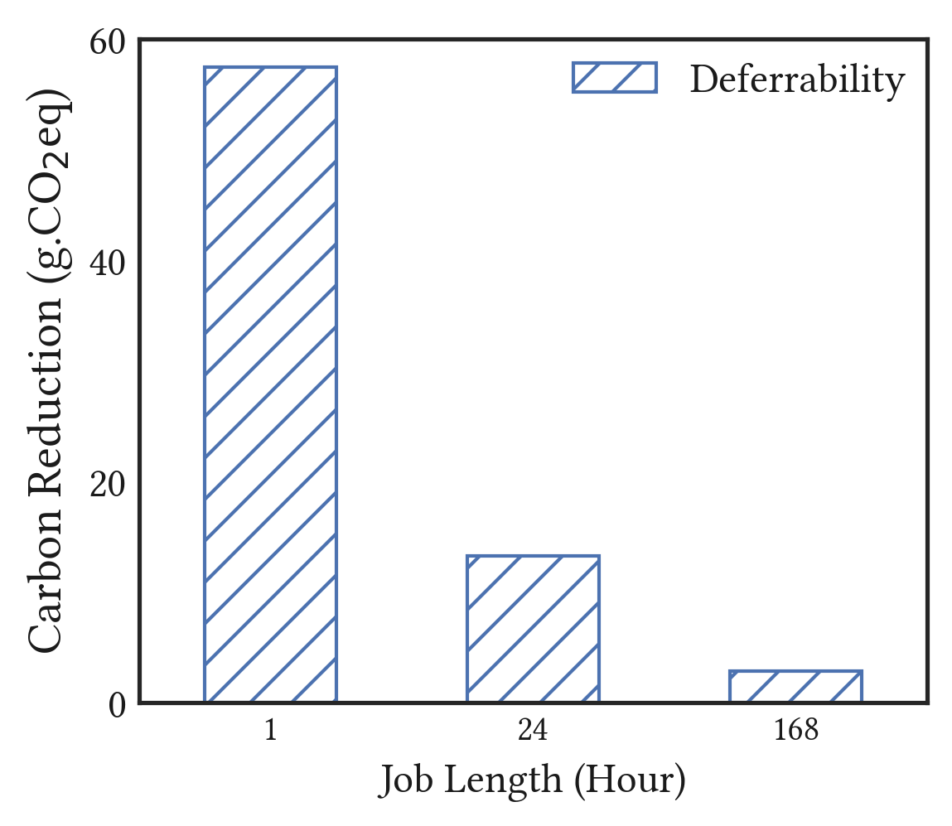
Temporal: Deferrability
Deferrability: Delay the job start time
Slack
CO₂ Intensity
time
Deferrability is beneficial for short jobs
24H Slack
Notes:
Next we move on to Temporal shifting and we first want to look into deferrability, which a delay in the job start time, and this delay is called slack. Given a 24H slack, it can be seen that the carbon reductions decreases as the job length increases. Here you can see that we have 1H, 24H and 168H job length, and you can see that deferrability is beneficial for short jobs.

Slide 14
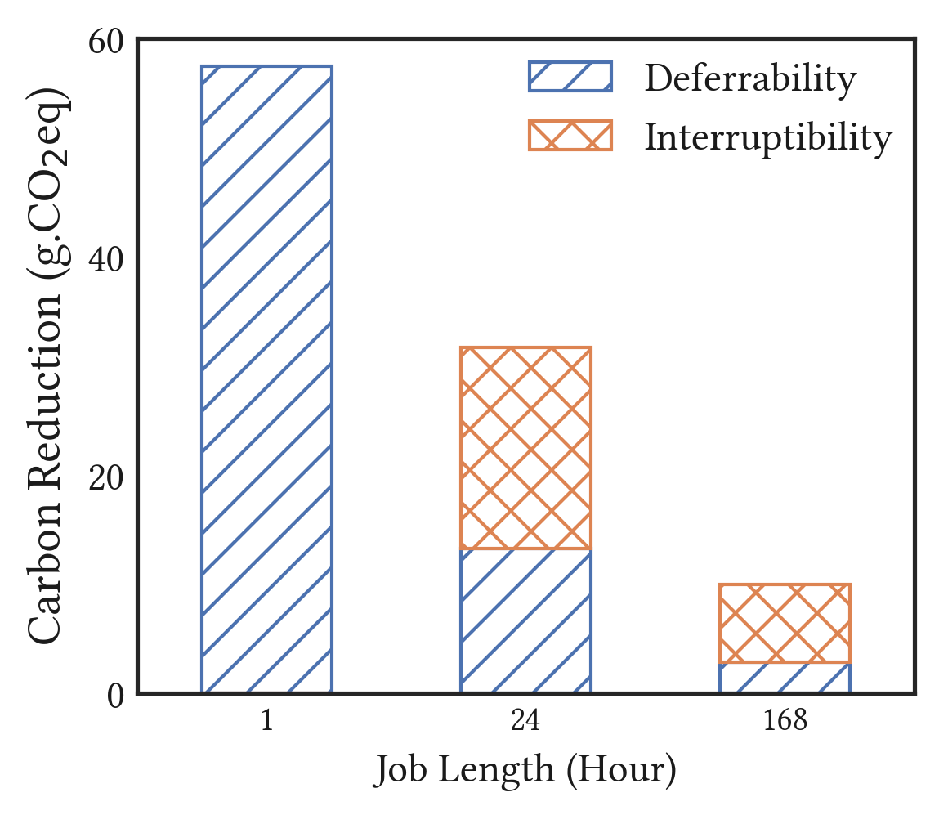
Temporal: Interruptibility
Interruptibility: suspend and resume
CO₂ Intensity
time
Interruptibility augments the carbon reductions for long jobs
24H Slack
Notes:
Next we look at the case where the workload can be suspended and resumed. It can be seen that adding interruptibility augments the carbon reductions for long jobs, however, the majority of the carbon reductions still come from deferrability. in reality there is overhead for interruptitibility, so the benefits diminish further

Slide 15
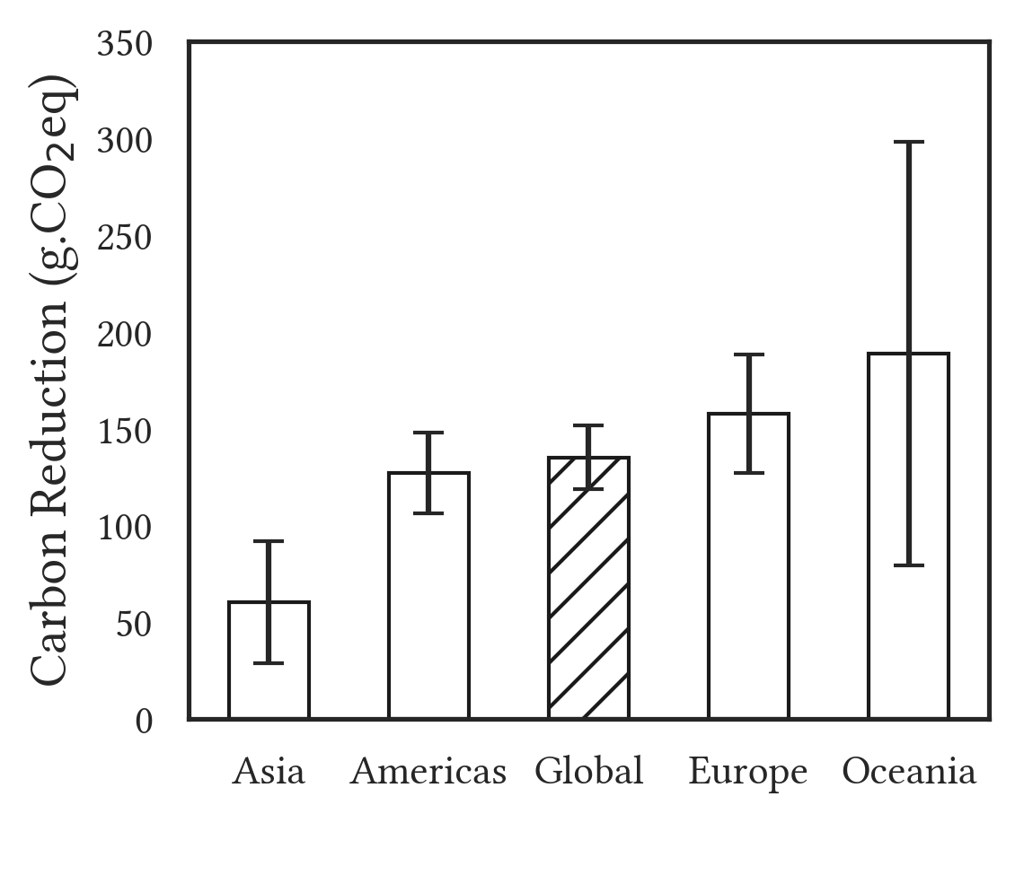
Temporal Workload Shifting
High variance → high reduction
But high variance regions are generally low-carbon regions
Low variance regions have high emissions but cannot enjoy the temporal shifting benefits
Notes:
Overall, the takeaway from temporal scheduling is that temporal scheduling offers more benefits to high variance regions (such as Oceania). However, the high variance regions are generally low-carbon intensity regions. On the other hand, the low variance regions are regions with high emissions but cannot enjoy the carbon reductions from temporal shifting, such as Asia.

Slide 16
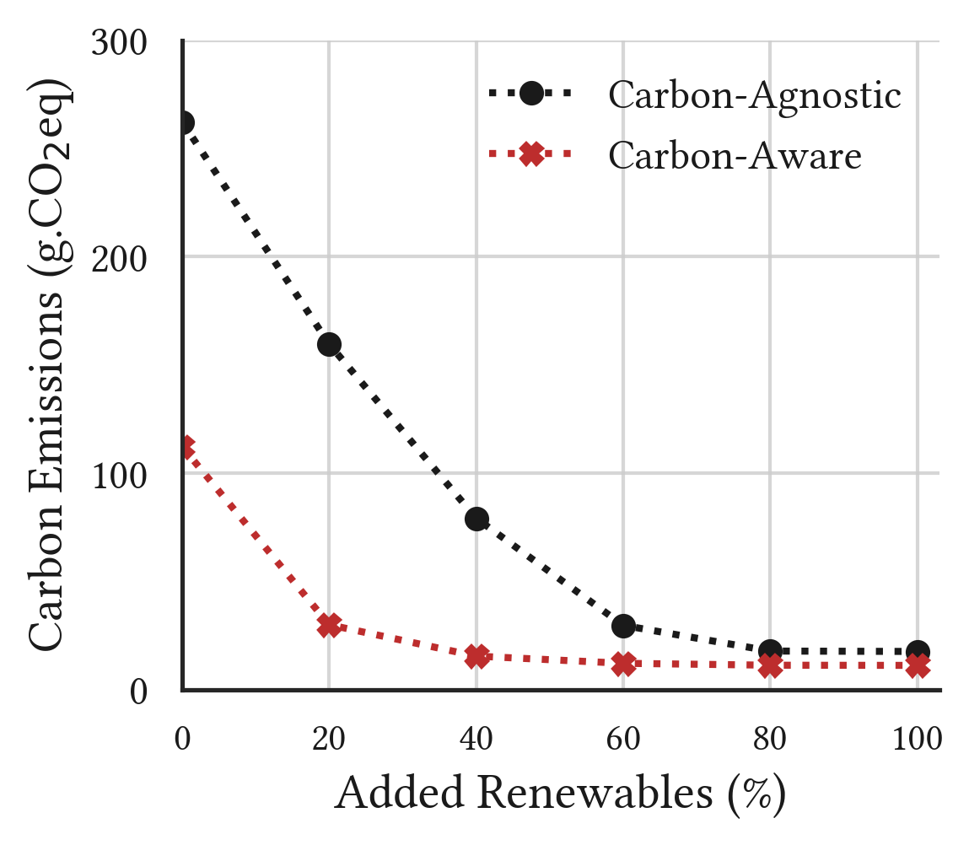
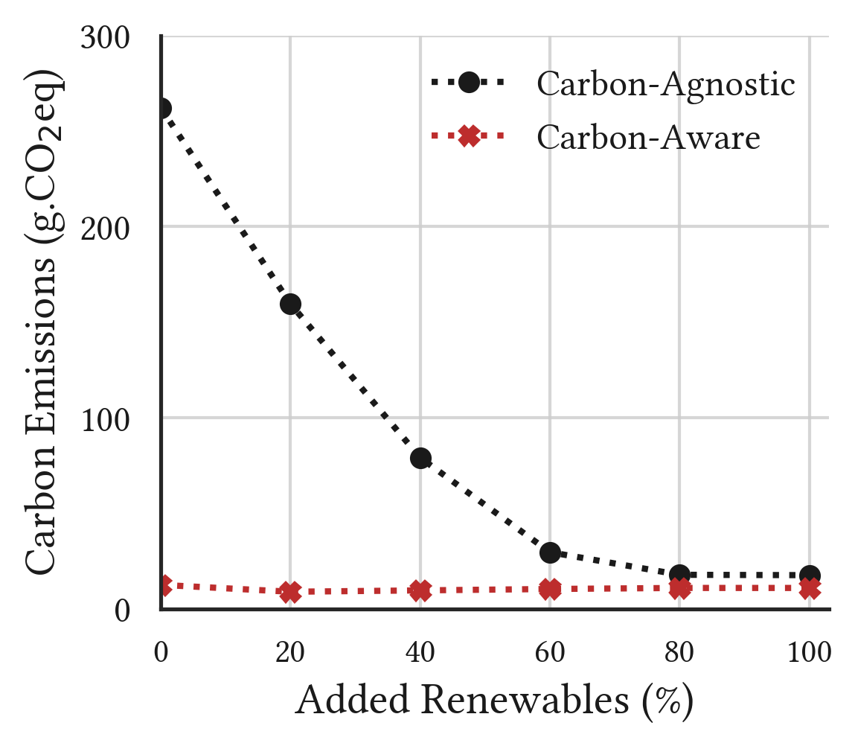
Increasing Renewables
Temporal: California
Spatial: California
Carbon-agnostic scheduling also results in low carbon emissions
Notes:
Another analysis that we look into is the scenario where there is an increase in renewables. Let’s take a look at California. When California has higher renewable penetration, the region's average carbon intensity also decreases, causing carbon-agnostic scheduling to also yield lower emissions. This implies that the benefits of carbon-aware scheduling diminish as the world's energy supply becomes greener.

Slide 17
Conclusion
The practical carbon reductions are far from ideal
Sophisticated migration techniques yields small additional carbon reduction
Temporal shifting has limited gains for long jobs and low-variance regions
The benefits of carbon-aware workload scheduling will decrease as the world's energy supply becomes “greener”
Notes:
To conclude this talk, the takeaways for this work are the following: The practical for carbon reductions are limited and far from ideal.
For spatial shifting, sophisticated migration techniques are not needed in the ideal scenario. On top of that, Temporal shifting has limited gains for long jobs and low-variance regions, and this is the case for the current state of the world.
Furthermore, the benefits of carbon-aware workload scheduling will decrease as the world's energy supply becomes “greener”.
Note that while this talk focuses on a batch job, we also discuss the interactive jobs and real world-traces in our paper. Please check our paper for more details.

Slide 18
Thank you
Questions?
On the Limitations of Carbon-Aware Temporal and Spatial Workload Shifting in the Cloud
Thanathorn Sukprasert
tsukprasert@umass.edu

